Slide 1

Introduction to
Part 1
Notes:
- Welcome and thank you for coming
- Introduction
- aims:
-- introduce fundamentals
-- build up confidence for self-study!!! Not as scary as the real-world version
- assumptions:
-- basic high-school maths
-- no prior experience in coding
CC-BY Digital Skills Team at the University of Edinburgh www.ed.ac.uk/is/skills

Slide 2

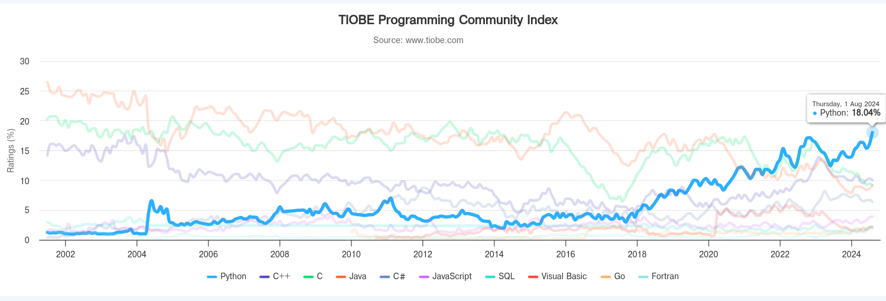
History
Started by Guido Van Rossum as a hobby
Now widely spread
Open Source! Free!
Versatile
Guido Van Rossum by Doc Searls on Flickr CC-BY-SA
Notes:
- Started by Guido Van Rossum as a hobby over the Christmas vacation.
- named after Monty Python's Flying Circus
- First released in 1991, loved by Unix scripters
- Now transformed into the most popular interpreted language. You can build anything with it!
- Facts! Python was the most used language in 2016 and still most likely is!

Slide 3
Python today
Developed a large and active scientific computing and data analysis community
Now one of the most important languages for
Data science
Machine learning
General software development
Packages: NumPy, pandas, matplotlib, SciPy, scikit-learn, statsmodels
Notes:
Why choose it instead of MATLAB, R, SAS, Stata and others?
- It is free and open source
- Intuitive and easy to learn
- Extremely versatile – examples – websites, planes, robots, data
- Large and friendly community
- packages
Very important in industry and academia

Slide 4
2 Modes
Jupyter
Python can be run in notebooks
Similar to Mathematica or MATLAB
Used extensively in research
2. Python scripts
What if we want to run more than a few lines of code?
Then we must write text files in .py
Notes:
Python has 2 modes of running
- IPython stands for Interactive Python
Python can be interpreted – good for a calculator
Live demo!

Slide 5
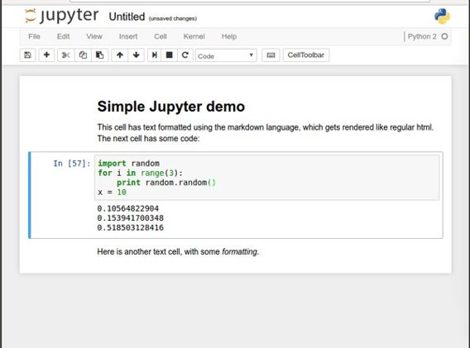
Jupyter notebooks
Easy to use environment
Web-based
Combines both text and code into one
Come with a great number of useful packages
Notes:
We will be using Noteable, just another service Jupyter Notebooks. It is free and open source
Web environment focused at Python
Easy to use – nice gui and no setup required
Block based. Has blocks which execute the code within it. Single type only
Allows to combine text and code into same page. Helps with readability

Slide 6
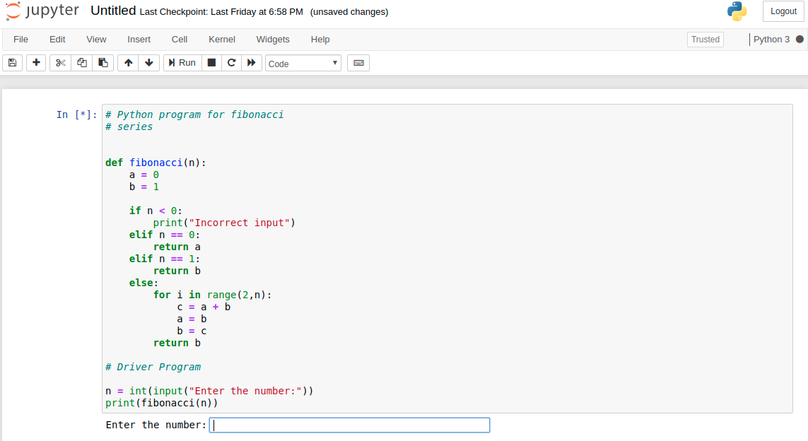


Setting up Python (3.x)
Can download from https://www.python.org and install basic python
But you will need to manually install scientific computing packages and modules (numpy, scipy, matplotlib etc.)
There are python ‘distributions’ where these are all bundled. Scientific-computing-specific distributions of python include ‘anaconda’
Instruction Video (in Bengali):
http://y2u.be/j64xgNo89qk
Notes:
We will be using Noteable, just another service Jupyter Notebooks. It is free and open source
Web environment focused at Python
Easy to use – nice gui and no setup required
Block based. Has blocks which execute the code within it. Single type only
Allows to combine text and code into same page. Helps with readability

Slide 7
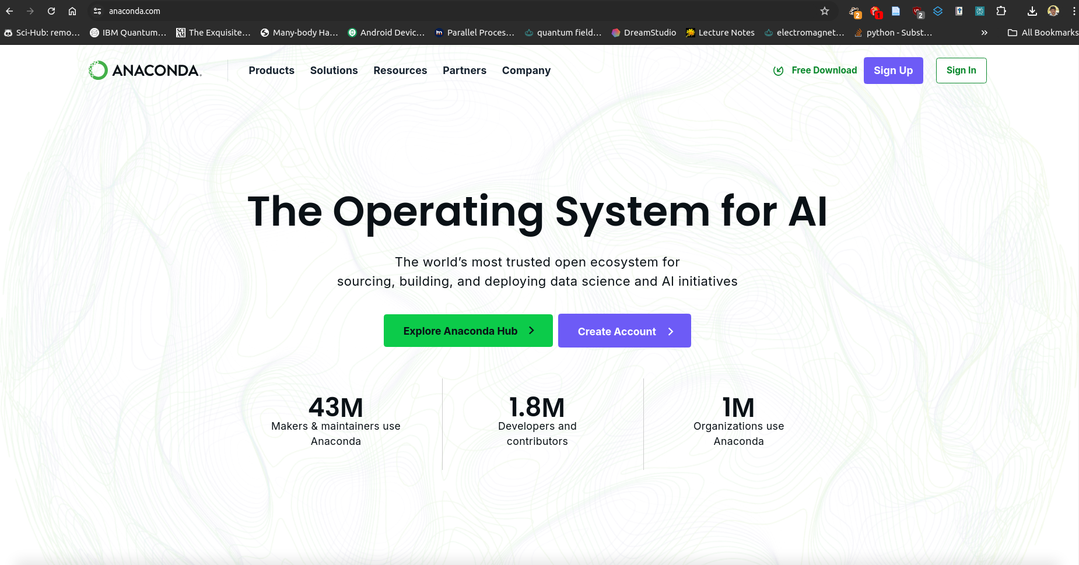
Download anaconda from https://anaconda.com

Slide 8
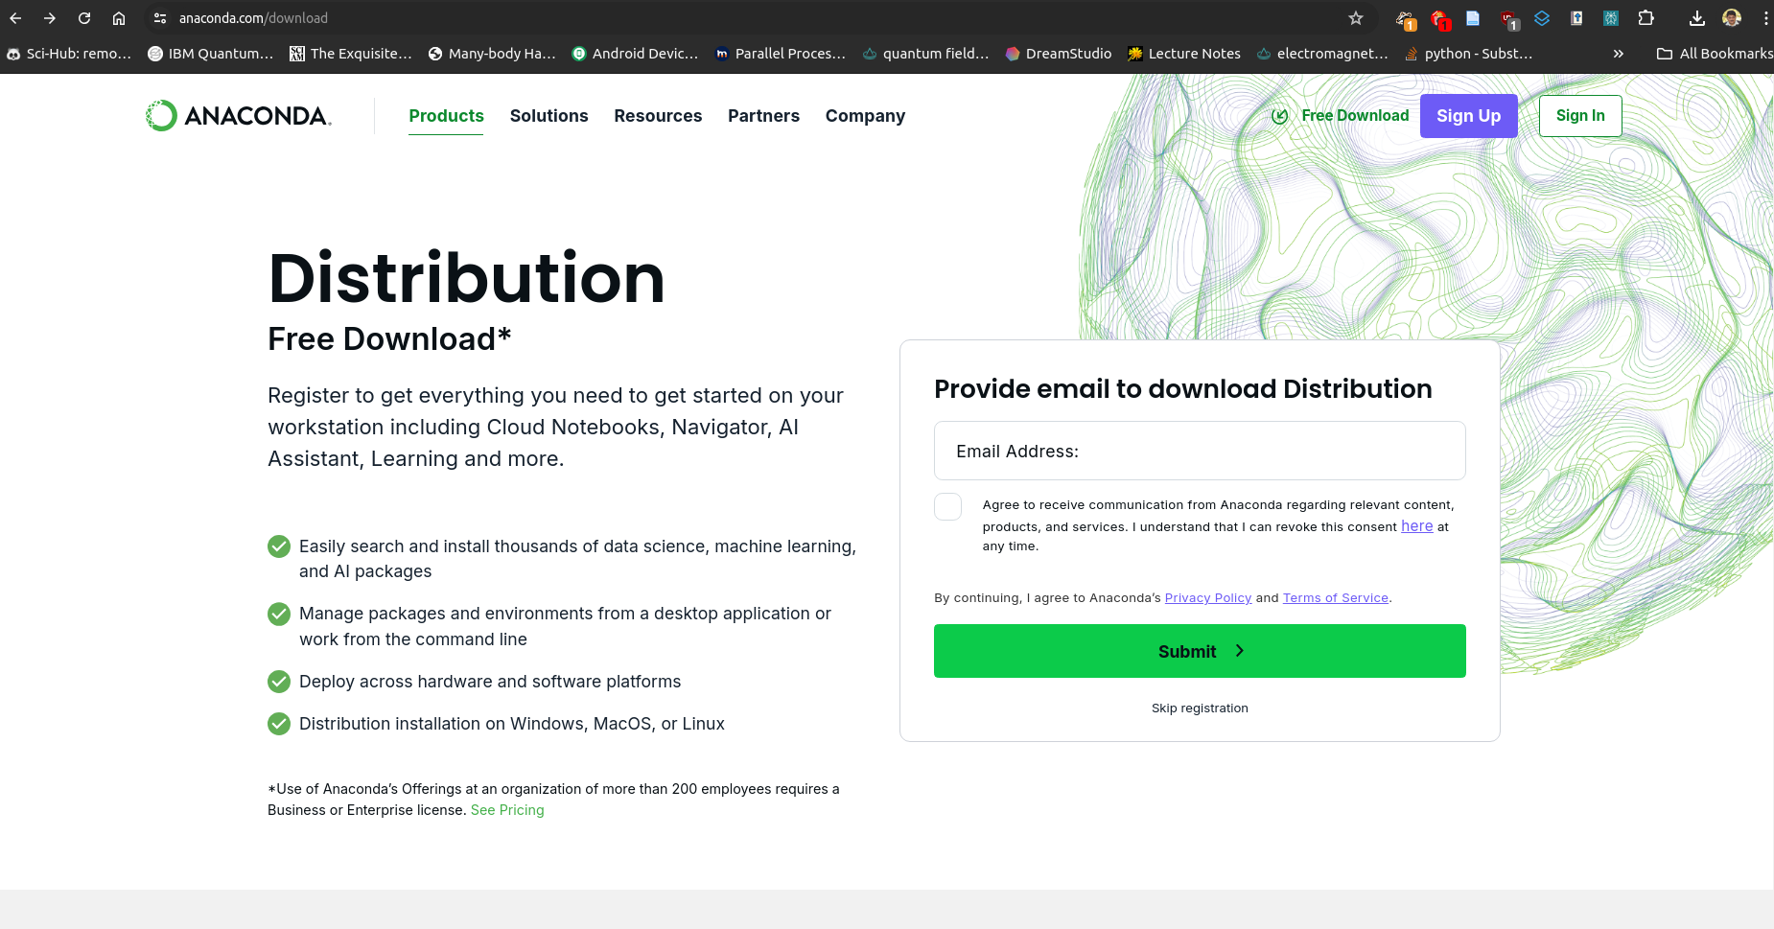
Download anaconda from https://anaconda.com
Download the installer app. Double-click it to install anaconda python

Slide 9
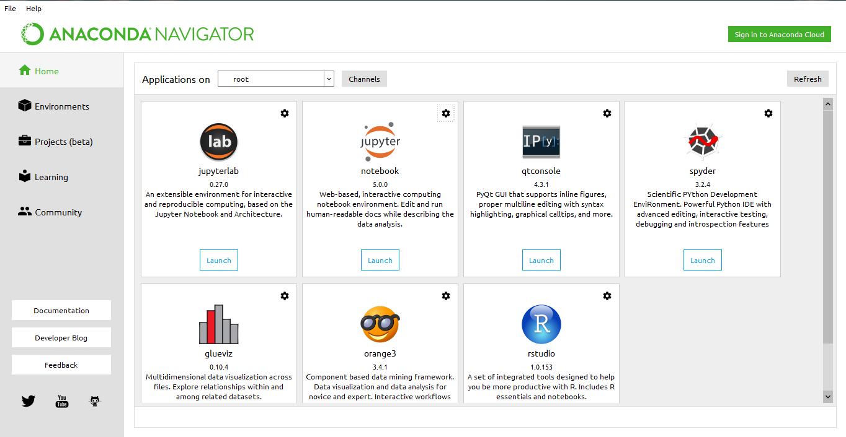
Setting up Python (3.x)
Download anaconda from https://anaconda.com
Install anaconda and start anaconda navigator
Notes:
We will be using Noteable, just another service Jupyter Notebooks. It is free and open source
Web environment focused at Python
Easy to use – nice gui and no setup required
Block based. Has blocks which execute the code within it. Single type only
Allows to combine text and code into same page. Helps with readability

Slide 10
Setting up Python (3.x)
Download anaconda from https://anaconda.com
Install anaconda and start anaconda navigator
Jupyter: Interactive python notebook (very user-friendly)
Notes:
We will be using Noteable, just another service Jupyter Notebooks. It is free and open source
Web environment focused at Python
Easy to use – nice gui and no setup required
Block based. Has blocks which execute the code within it. Single type only
Allows to combine text and code into same page. Helps with readability

Slide 11
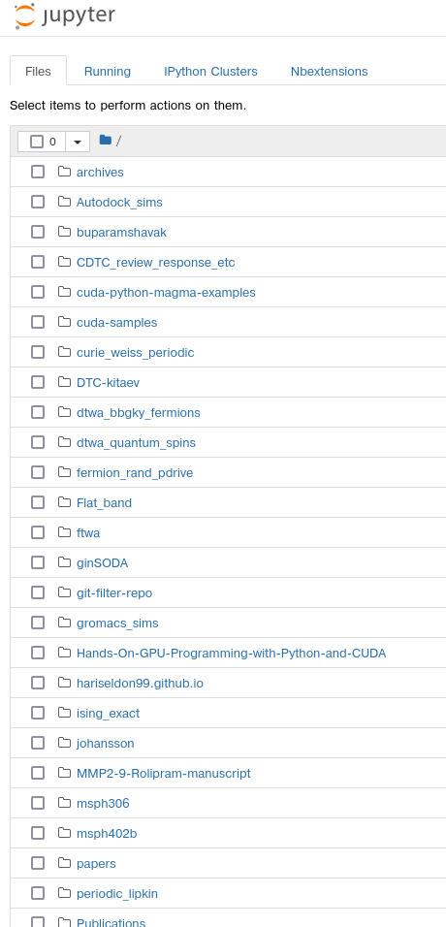
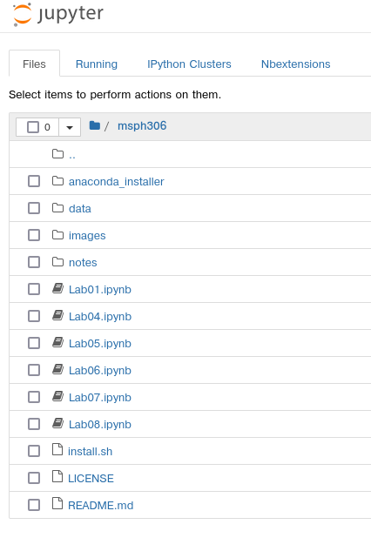
3. Starting a notebook
Notes:
Start a notebook by clicking on it.
Notebook 0 is an environment introduction.
Skip that, open notebook 1
Make sure that everybody is ready

Slide 12
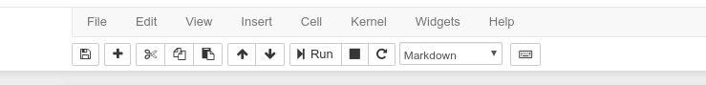
4. Toolbar
Stop execution
Save
Cut, copy
paste
Cell type
New cell
Move cell
Reset cell
And clear output
Notes:
Autosave

Slide 13
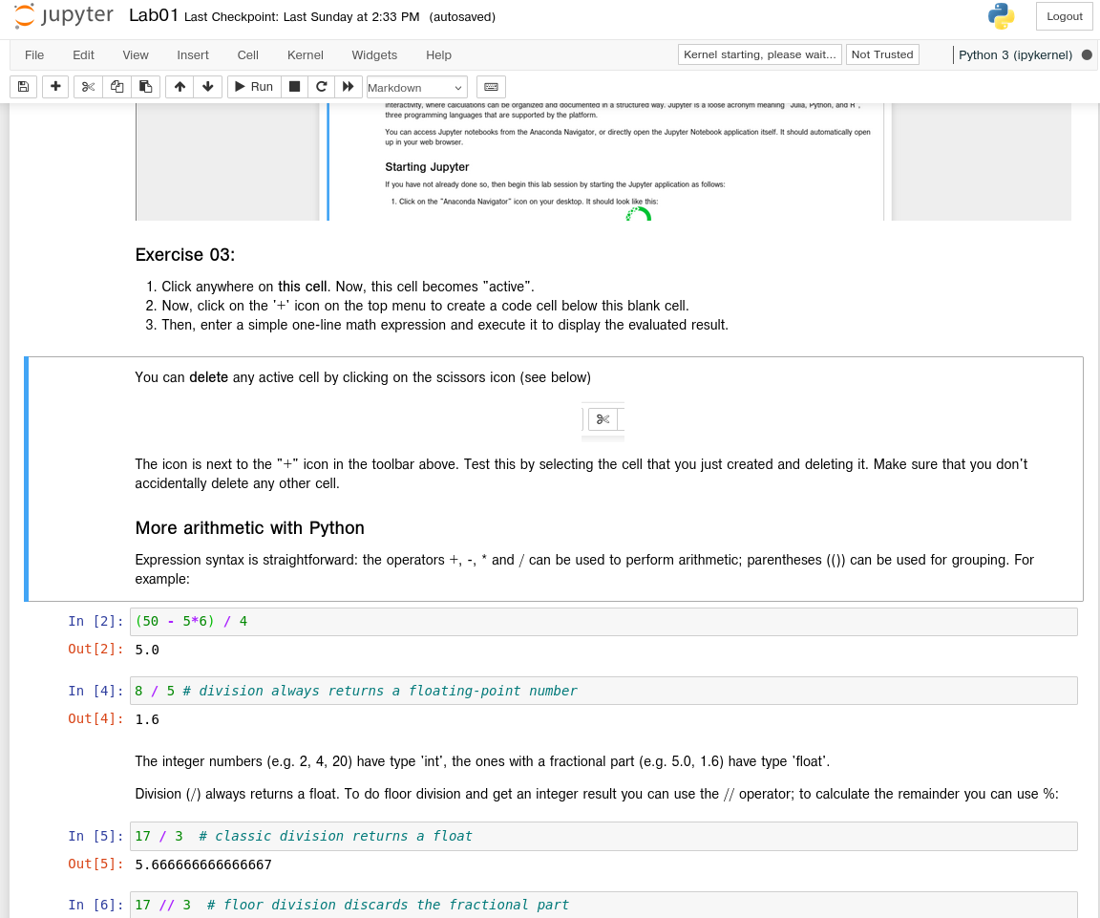
5. Notebook: Cells
Text Cell

Slide 14
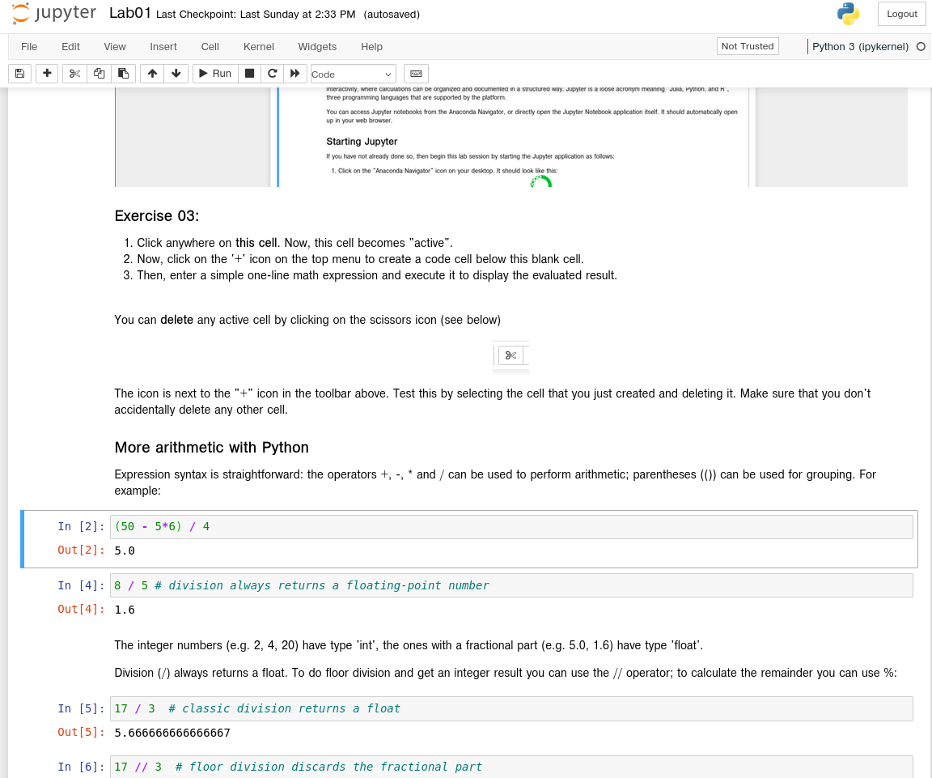
5. Notebook: Cells
Code Cell

Slide 15
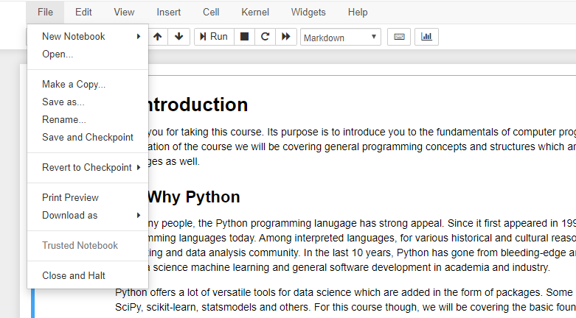
6. File/ Close & Halt

Slide 16
Running cells
By pressing the Run button
Shift + Enter – runs cell
Alt + Enter – creates a new cell
Notes:
Run button but its best with shortcut Shift + Return/Enter
Alt + Return/Enter which creates a new block after the on you are currently on.

Slide 17
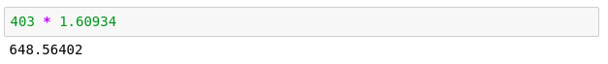
Python as a calculator
Let us calculate the distance between Edinburgh and London in km
Notes:
Let's run our first block.
That's great
Writing numbers is very tedious
Run this in your notebooks
How can we improve that?

Slide 18
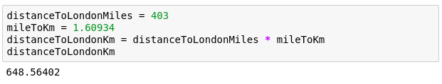
Variables
Great calculator but how can we make it store values?
Do this by defining variables
Can later be called by the variable name
Variable names are case sensitive and unique
Notes:
Can we save values? By defining a variable.
Can have values assigned
Variables must be declared and can then be called by name.
Code example
Check the code yourself

Slide 19
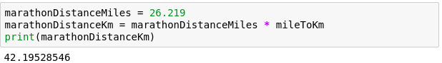
We can now reuse the variable mileToKm in the next block without having to define it again!
Notes:
reuse without having to type in again
Note: mileToKm not defined again

Slide 20
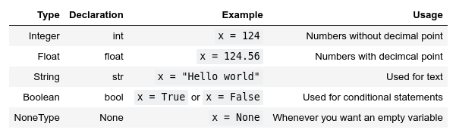
Types
Variables actually have a type, which defines the way it is stored.
The basic types are:
Notes:
So far - storing values in memory; how exactly are they stored?
defined by the type.
Go over all types

Slide 21
Why should we care about types?
Notes:
Python decides the types, why should we care?
Python uses duck typing
Try running the next block

Slide 22
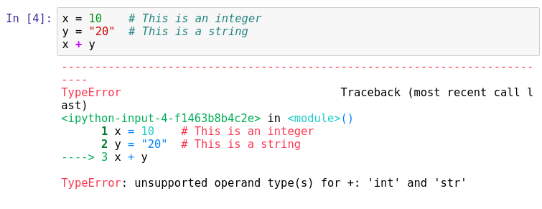
Important lesson to remember!
We can't do arithmetic operations on variables of different types. Therefore make sure that you are always aware of your variables types!
You can find the type of a variable using type(). For example type type(x).
Notes:
Explain code, run it.
we broke python. Any ideas?
Don't be afraid of errors, they are invaluable
we can't add up variables of different types.
important to remember! always take note of what the types of your variables are!
Python is helpful and gives us a hint.
Can you fix this particular block?

Slide 23
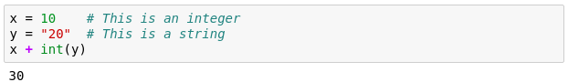
Casting types
Luckily Python offers us a way of converting variables to different types!
Casting – the operation of converting a variable to a different type
Similar methods exist for other data types: int(), float(), str()
Notes:
Casting – the operation of converting a variable to a different type
Let's try it on the previous code snippet.
Take note that this works only in a sensible way!

Slide 24
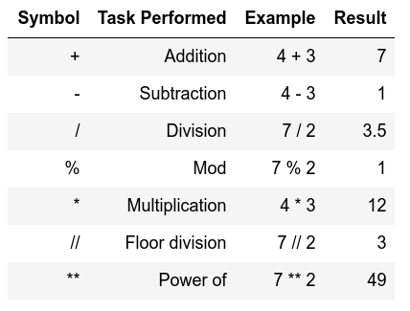
Arithmetic operations
Similar to actual Mathematics.
Order of precedence is the same as in Mathematics.
We can also use parenthesis ()
Notes:
Note of order precedence.
Table doesn't show this
Should be intuitive for all of you.

Slide 25
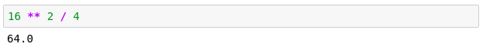
Order precedence example

Slide 26
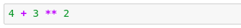
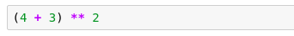
Quick quiz
vs
13
49

Slide 27
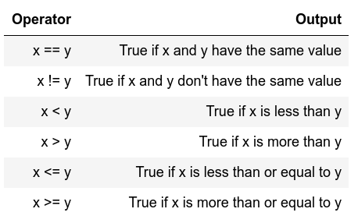
Comparison operators
I.e. comparison operators
Return Boolean values
(i.e. True or False)
Used extensively for conditional statements
Notes:
Similar to mathematics again
Will become important later on.

Slide 28
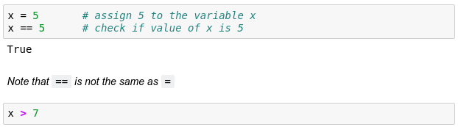
Comparison examples
False
Notes:
Note variable passing down
What will the 2nd block return?

Slide 29
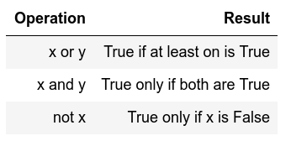
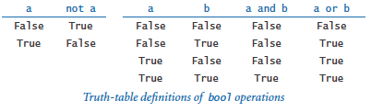
Logical operators
Allows us to extend the conditional logic
Will become essential later on
Notes:
how we can combine comparison operators and logical operators

Slide 30
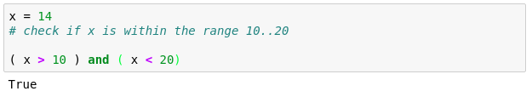
Combining both
True
True

Slide 31
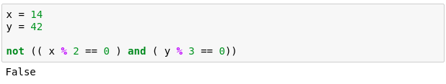
Another example
True
True
True
That wasn't very easy to read was it?
Is there a way we can make it more readable?
Notes:
Another more complex example.
Here we check if x is divisible by 2 and if y is divisible by 3.
Can anybody guess why we are getting False?

Slide 32
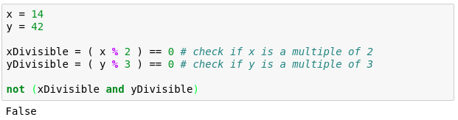
Notes:
Simpler – store intermediate values
Easier to read
Generally advised

Slide 33
Strings
Powerful and flexible in Python
Can be added
Can be multiplied
Can be multiple lines

Slide 34
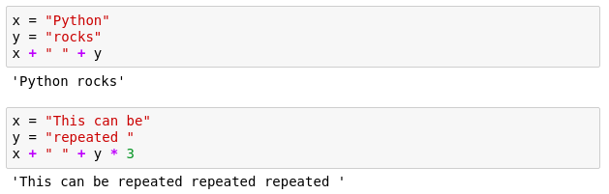
Strings

Slide 35
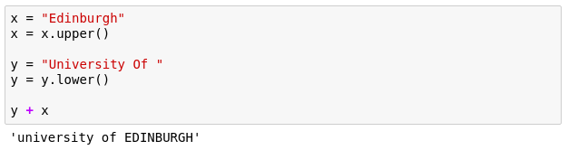
Strings
These are called methods and add extra functionality to the String.
If you want to see more methods that can be applied to a string simply type in dir('str')
Notes:
Functionality of strings can be extended through methods
should be in your notebooks but the dir() can be used on any Object/variable

Slide 36
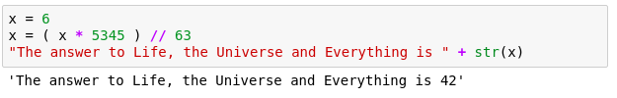
Mixing up strings and numbers
Often we would need to mix up numbers and strings.
It is best to keep numbers as numbers (i.e. int or float)
and cast them to strings whenever we need them as a string.
Notes:
We need to mix numbers and strings often, ie. Whenever printing.
best to keep numbers as numbers
cast them to strings whenever needed.

Slide 37
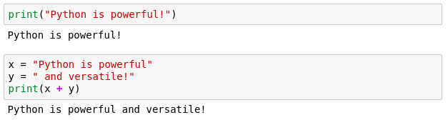
Printing
When writing scripts, your outcomes aren't printed on the terminal.
Thus, you must print them yourself with the print() function.
Beware to not mix up the different type of variables!

Slide 38
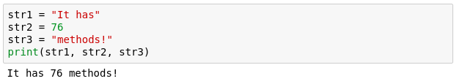
Another more generic way to fix it
If we comma separate statements in a print function we can have different variables printing!

Slide 39
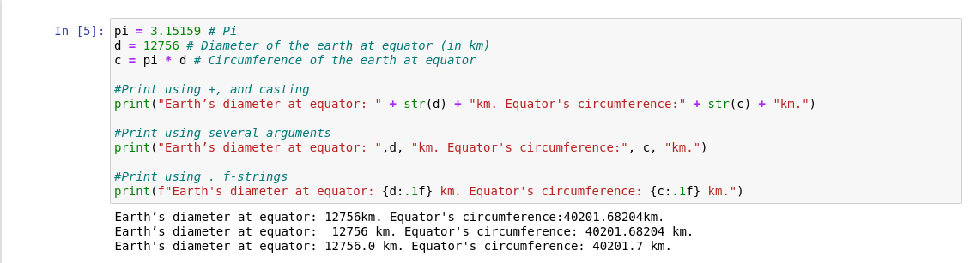
Placeholders ↔ f-strings
A way to interleave numbers is
Elegant and easy
Notes:
More examples including Exp, Octal, Hex, Etc in your notebooks

Slide 40
Commenting
Useful when your code needs further explanation. Either for your future self and anybody else.
Useful when you want to remove the code from execution but not permanently
Comments in Python are done with #
Notes:
You seen the # symbols in the slides.
I forget what I write; need to remind my future self
Programmers though it's better to write explanation in between the code
Show example

Slide 41
Idioms ( বাগ্ধারা )
Python is strongly idiomatic
There is usually a simple idiom of instructions for particular types of complex tasks
These are tasks that are frequently needed
This is unlike lower level languages like C, where even standard tasks require specific instructions
Example: Swapping two values
main() { float a, b, temp; … … //swap a and b temp = a; a = b; b = temp; … } | >> a = … >> b = … # swap a and b >> b, a = a, b …
C/C++ | Python
Notes:
You seen the # symbols in the slides.
I forget what I write; need to remind my future self
Programmers though it's better to write explanation in between the code
Show example

Slide 42
Idioms ( বাগ্ধারা )
Python is strongly idiomatic
There is usually a simple idiom of instructions for particular types of complex tasks
These are tasks that are frequently needed
This is unlike lower level languages like C, where even standard tasks require specific instructions
Example: String Methods - Concatenate
#include <stdio.h> #include <string.h> main() { char str1[] = "This class is “; char str2[] = "msph306"; // concatenates str1 and str2 // the resultant string is stored in str1. strcat(str1, str2); puts(str1); } | str1= "This class is " str2 = "msph306" print(str1 + str2)
C/C++ | Python
Notes:
You seen the # symbols in the slides.
I forget what I write; need to remind my future self
Programmers though it's better to write explanation in between the code
Show example

